Slide 1
Control statements and Loops in Python

Slide 2
Lines and Indentation in Python
Indentation in Python refers to the (spaces and tabs) that are used at the beginning of a statement.
Python provides no braces to indicate blocks of code for class and function definitions or flow control.
Blocks of code are denoted by line indentation, which is rigidly enforced.
The number of spaces in the indentation is variable, but all statements within the block must be indented the same amount.

Slide 3
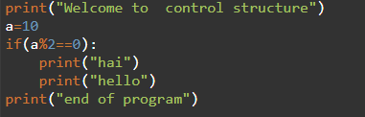

Simple if:
Syntax:
if boolean-expression:
#statement1
#statement2
#statement3
Example:

Slide 4
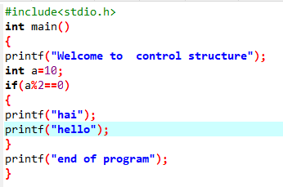
Simple if:
C Code
Python Code

Slide 5
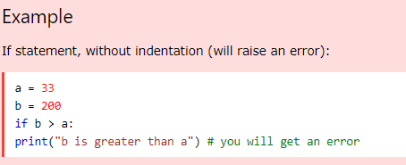
Simple if:

Slide 6
Short Hand If
If you have only one statement to execute, you can put it on the same line as the if statement.
Example:
One line if statement:
if a > b: print("a is greater than b")

Slide 7
if else:
Syntax:
if boolean-expression:
#statement1
#statement2
#statement3
else:
#statement1
#statement2
#statement3

Slide 8
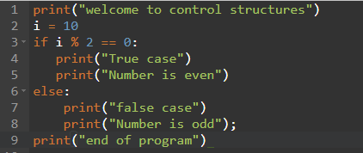

if else example:

Slide 9
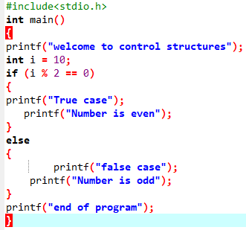
if else example:
C Code
Python Code

Slide 10
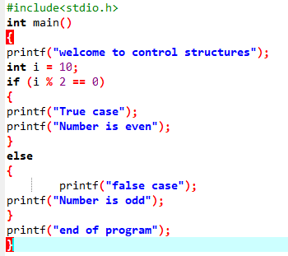
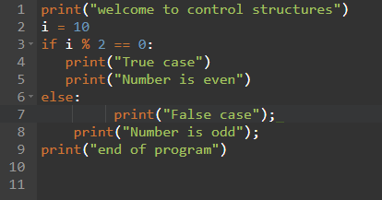
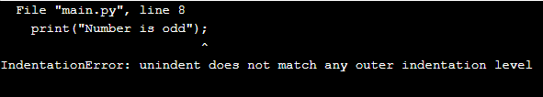
if else example:
C Code
Python Code
No error

Slide 11
Short Hand If ... Else
If you have only one statement to execute, one for if, and one for else, you can put it all on the same line:
Example
Script1:
a = 2 b = 330 print("A") if a > b else print("B")
OUTPUT:
B
Script2:
a = 2000 b = 330 print("A") if a > b else print("B")
OUTPUT:
A

Slide 12
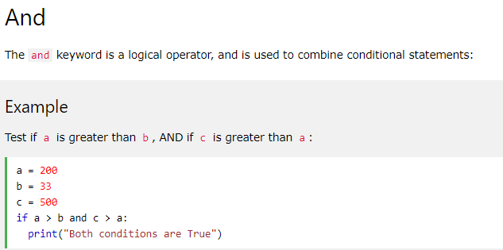

Slide 13
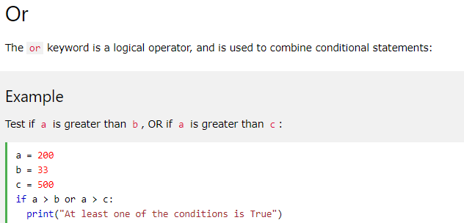

Slide 14
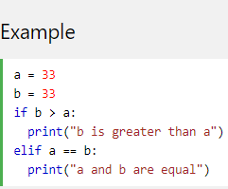
elif
The elif keyword is pythons way of saying "if the previous conditions were not true, then try this condition".
OUTPUT:
a and b are equal

Slide 15
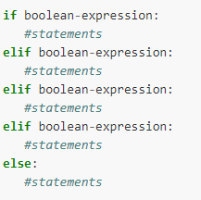
if-elif-else statement
Syntax

Slide 16
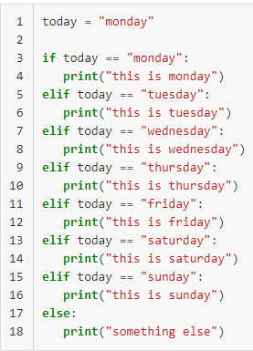
if-elif-else Example

Slide 17
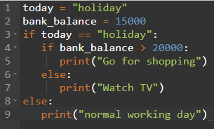
Nested if statements
OUTPUT

Slide 18
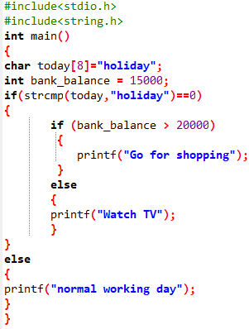
Nested if statements
C Code
Python Code

Slide 19
pass Statement:
if statements cannot be empty, but if you for some reason have an if statement with no content, put in the pass statement to avoid getting an error.
Example
a = 33 b = 200 if b > a: pass

Slide 20

While Loop:
In python, while loop is used to execute a block of statements repeatedly until a given a condition is satisfied.
Syntax :
while expression:
statement(s)
All the statements indented by the same number of character spaces after a programming construct are considered to be part of a single block of code.
Example:
count = 0 while (count < 3): count = count + 1 print("Hello Geek")

Slide 21

While Loop:

Slide 22
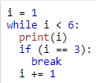

break Statement
With the break statement we can stop the loop even if the while condition is true:

Slide 23
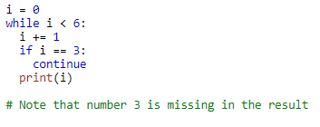

continue Statement
With the continue statement we can stop the current iteration, and continue with the next

Slide 24
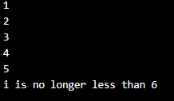
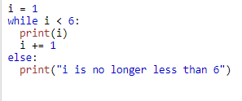
else Statement in while loop:
With the else statement we can run a block of code once when the condition no longer is true:

Slide 25
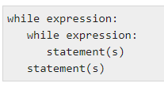
nested while loop
Syntax:

Slide 26
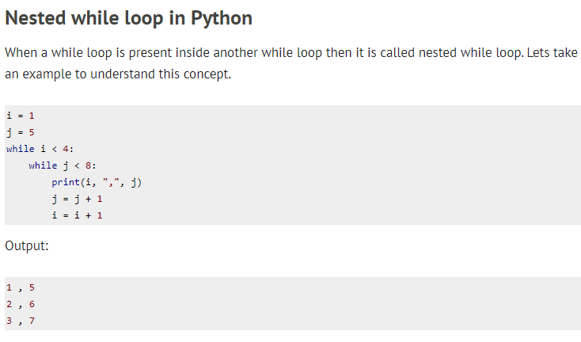

Slide 27
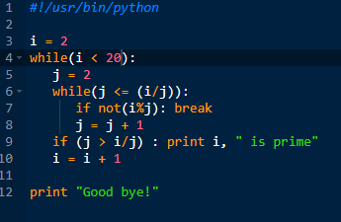
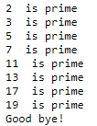
nested while loop
OUTPUT

Slide 28
Python For Loops
A for loop is used for iterating over a sequence (that is either a list, a tuple, a dictionary, a set, or a string).
Syntax:
for var in iterable:
# statements
iterable is a collection of objects like list, tuple.
The variable var takes the value of next item of the iterable each time through the loop.

Slide 29
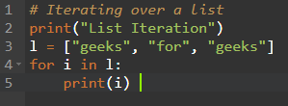

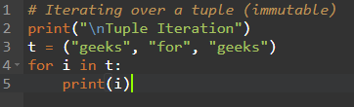

Python For Loops

Slide 30
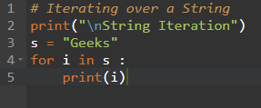
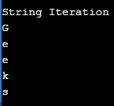
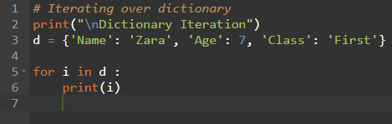

Python For Loops

Slide 31
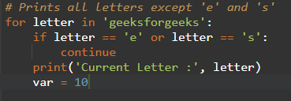
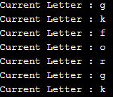
Continue Statement in for loop:
It returns the control to the beginning of the loop.

Slide 32
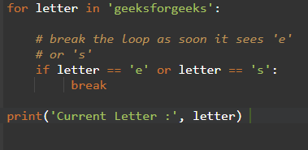

Break Statement in for loop:
It brings control out of the loop.

Slide 33
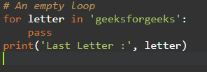
Pass Statement in for loop:
We use pass statement to write empty loops. Pass is also used for empty control statements, function and classes.

Slide 34
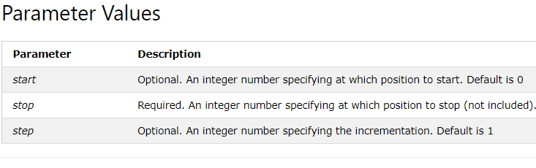
Python range() Function
The range() function returns a sequence of numbers, starting from 0 by default, and increments by 1 (by default), and stops before a specified number.
Syntax
range(start, stop, step)

Slide 35



Python range() Function

Slide 36


Python range() Function

Slide 37
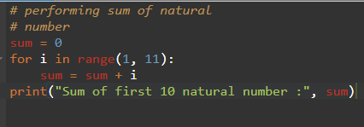
Python range() Function

Slide 38




Python range() Function
No output

